Slide 1
Modelling Errors

Slide 2
Modelling Errors
All models are impacted by three types of errors which reduce their predicting power.
Variance errors
Bias error
Random errors
Variance errors
Caused by the random factors that impact the process that generate the data
The population / universe, representing the infinite data points continuously jiggle
Sample drawn from such universe is a snapshot of a small part of the universe
The model based on a sample will perform differently on different samples
Variance errors increase with increase in number of attributes in the model due to increase in degrees of freedom for the data points to wriggle in
Bias errors
Caused by our selection of the attributes and our interpretation of their influence on each other
The real model in the universe / population may have many more attributes and the attributes interacting in different ways not reflected in our model
Random errors
Caused by unknown factors. They cannot be modelled

Slide 3
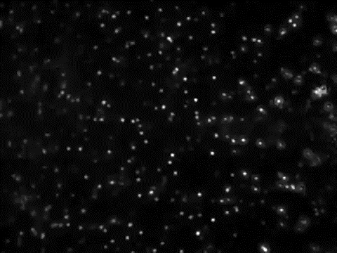
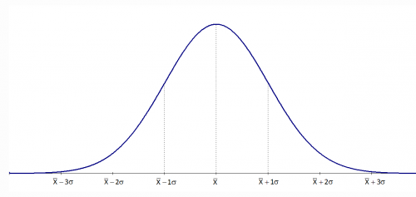
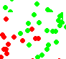
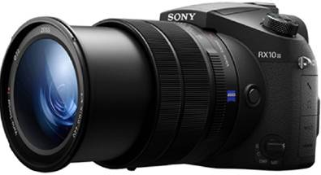
Modelling Errors – Variance error
Universe / Population
Time T1
Time T2
Sample / snapshot

Slide 4
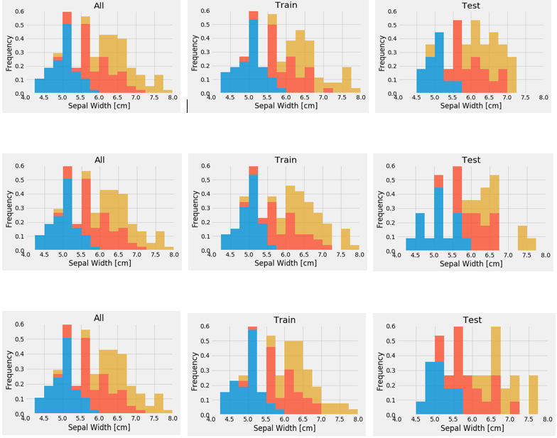
Modelling Errors Visaual demo of variance in training and test data
Sample Data (Analytics Base Table)
Three Random Training Sets From ABT
Three Random Test Sets From ABT

Slide 5
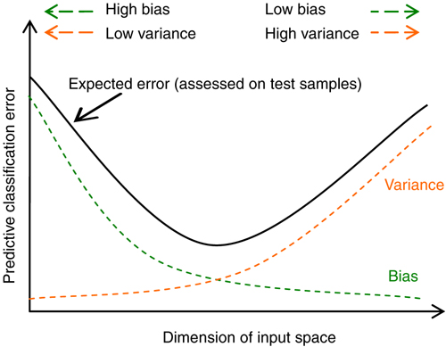
Modelling Errors
We have to find the right attributes and the right number of dimensions such that the total effect of these two (indicated by black curve) minimizes.
The gap between variance curve and total error curve reflects presence of random errors in the model

Slide 6
Fitness of a Model
Generalize
Models are expected to perform well (meet least accuracy thresholds) in production (real world data)
But data in real world is under flux / jiggle
Models have to perform in this context of continuous jiggle. Such models are said to generalize well
For models to generalize well, they should neither be underfit or overfit in the training data
Underfit models
Models that are over simplified i.e. models in which the independent and dependent attributes interact in a simple linear way ( can be expressed in a linear form for e.g. y = mx + c).
The model could have been addressed as a quadratic form such as y = m1x + m2 x^2 +C
Underfit models result in errors as they fail to capture the complex interactions among the attributes in the real world
These models will not generalize in the real world
Overfit models
Models that perform very well (sometimes with zero errors) in training data
Are complex polynomial surfaces that twist and turn in the feature space to cleanly separate the classes
Adjust to the variance in the training data i.e. try to adjust to the positions of the data points though those positions are not the expected values of the data points (mean of the jiggle)
These models adapt to the variance error in the data set and will not generalize in the real world

Slide 7
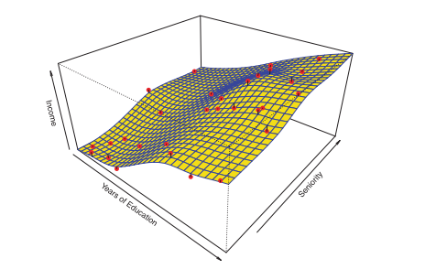
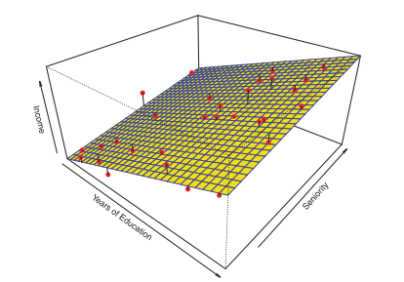
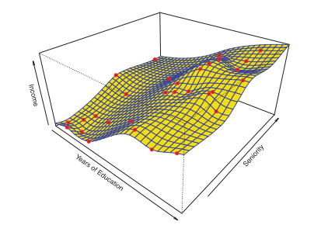
Good fit
Over fit
Underfit
In overfit models, the models absorb the noise (variance) in the data points achieving almost 100% accuracy in controlled environment. But when used in production (where the data points have different variance, the models will perform poorly

Slide 8
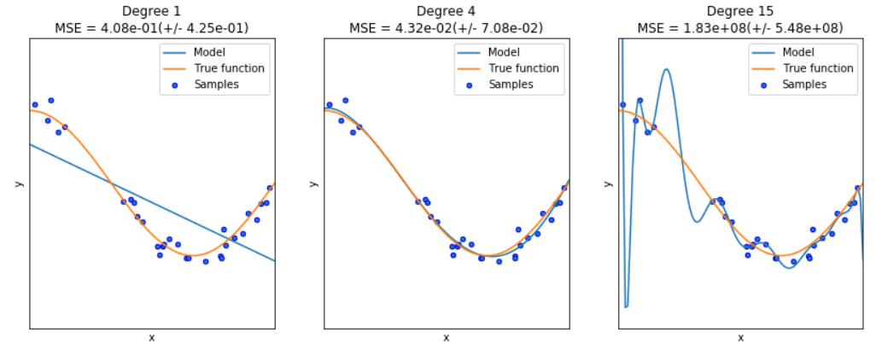
Fitness of a Model
Under Fit
Good Fit
Over Fit
When the interaction between the attributes and target dimensions are oversimplified. Fail to generalize
Right fit. Will generalize relatively much better
When the interaction between the attributes and target dimensions are overly complex in the model. Fail to generalize

Slide 9


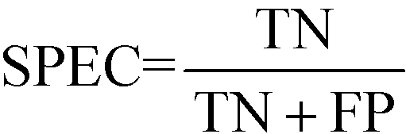

Model performance measures
Confusion Matrix – A 2X2 tabular structure reflecting the performance of the model in four blocks
Accuracy – How accurately / cleanly does the model classify the data points. Lesser the false predictions, more the accuracy
Sensitivity / Recall – How many of the actual True data points are identified as True data points by the model . Remember, False Negatives are those data points which should have been identified as True.
Specificity – How many of the actual Negative data points are identified as negative by the model
Precision – Among the points identified as Positive by the model, how many are really Positive
Confusion Matrix | Predicted Positive | Predicted Negative
Actual Positive | True Positive | False Negative
Actual Negative | False Positive | True Negative

Slide 10
ThankYou

